Slide 1



Dynamic Programming
Solving Optimization Problems with Dynamic Programming Part 2
DP
SoftUni Team
Technical Trainers
Software University
http://softuni.bg

Slide 2
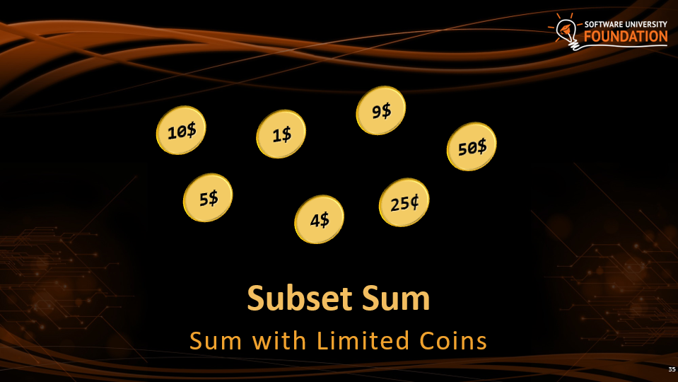
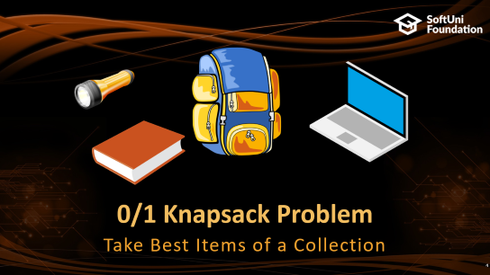
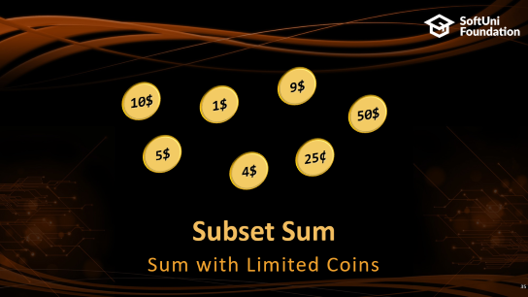
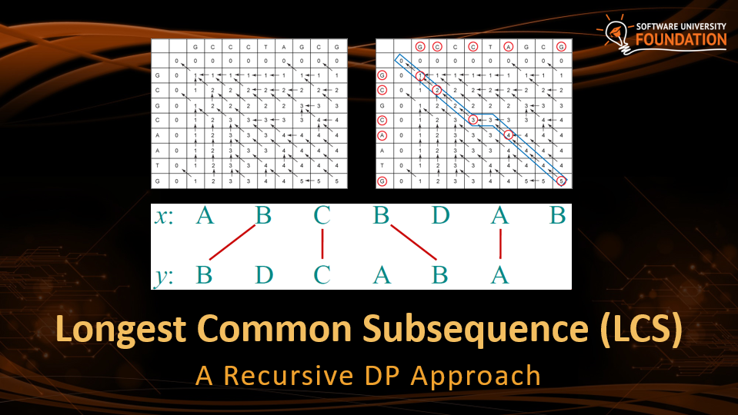

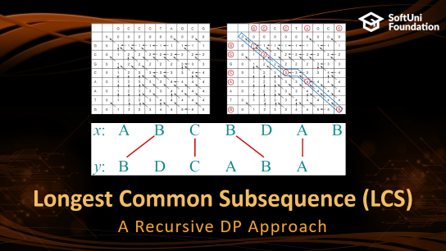
Table of Contents

Slide 3
Have a Question?
sli.do #DsAlgo

Slide 4




0/1 Knapsack Problem
Take Best Items of a Collection

Slide 5
The "Knapsack" Problem
We have n items
Each item has price c_{i} and weight w_{i}
We have a knapsack of given capacity (maximum weight)
We want to take maximal priced items within the knapsack capacity
Take a subset of the items, so that:
The total price is maximal
The total weigth ≤ capacity

Slide 6


The "Knapsack" Problem – Example
Value: 3
Weight: 2
Value: 1
Weight: 2
Max Capacity: 4
Value: 3
Weight: 1

Slide 7





The "Knapsack" Problem – Example
Max Capacity: 4
Value: 3
Weight: 2
Value: 1
Weight: 2
Value: 3
Weight: 1
 | 0 | 1 | 2 | 3 | 4
No Items

Slide 8
The "Knapsack" Problem – Example
Max Capacity: 4
Value: 3
Weight: 2
Value: 1
Weight: 2
Value: 3
Weight: 1
 | 0 | 1 | 2 | 3 | 4
No Items | 0 | 0 | 0 | 0 | 0

Slide 9
The "Knapsack" Problem – Example
Max Capacity: 4
Value: 3
Weight: 2
Value: 1
Weight: 2
Value: 3
Weight: 1
 | 0 | 1 | 2 | 3 | 4
No Items | 0 | 0 | 0 | 0 | 0
 | 0
 | 0
 | 0

Slide 10
The "Knapsack" Problem – Example
Max Capacity: 4
Value: 3
Weight: 2
Value: 1
Weight: 2
Value: 3
Weight: 1
 | 0 | 1 | 2 | 3 | 4
No Items | 0 | 0 | 0 | 0 | 0
 | 0
 | 0
 | 0
Excluding current item value:
matrix[index -1][capacity]
Including current item value:
value + matrix[index - 1][capacity - weight]
Choosing if we are going to take the item
max(excluding, including)

Slide 11
The "Knapsack" Problem – Example
Max Capacity: 4
Value: 3
Weight: 2
Value: 1
Weight: 2
Value: 3
Weight: 1
 | 0 | 1 | 2 | 3 | 4
No Items | 0 | 0 | 0 | 0 | 0
 | 0
 | 0
 | 0
Excluding current item value:
excluding = 0
Including current item value:
including = 0
Weight > Capacity
Choosing if we are going to take the item
max(excluding, including)

Slide 12

The "Knapsack" Problem – Example
Max Capacity: 4
Value: 3
Weight: 2
Value: 1
Weight: 2
Value: 3
Weight: 1
 | 0 | 1 | 2 | 3 | 4
No Items | 0 | 0 | 0 | 0 | 0
 | 0 | 0
 | 0
 | 0
Excluding current item value:
matrix[index -1][capacity]
Including current item value:
value + matrix[index - 1][capacity - weight]
Choosing if we are going to take the item
max(excluding, including)

Slide 13

The "Knapsack" Problem – Example
Max Capacity: 4
Value: 3
Weight: 2
Value: 1
Weight: 2
Value: 3
Weight: 1
 | 0 | 1 | 2 | 3 | 4
No Items | 0 | 0 | 0 | 0 | 0
 | 0 | 0 | 3
 | 0
 | 0
Excluding current item value:
matrix[index -1][capacity]
Including current item value:
value + matrix[index - 1][capacity - weight]
Choosing if we are going to take the item
max(excluding, including)

Slide 14
The "Knapsack" Problem – Example
Max Capacity: 4
Value: 3
Weight: 2
Value: 1
Weight: 2
Value: 3
Weight: 1
 | 0 | 1 | 2 | 3 | 4
No Items | 0 | 0 | 0 | 0 | 0
 | 0 | 0 | 3 | 3
 | 0
 | 0
Excluding current item value:
matrix[index -1][capacity]
Including current item value:
value + matrix[index - 1][capacity - weight]
Choosing if we are going to take the item
max(excluding, including)

Slide 15
The "Knapsack" Problem – Example
Max Capacity: 4
Value: 3
Weight: 2
Value: 1
Weight: 2
Value: 3
Weight: 1
 | 0 | 1 | 2 | 3 | 4
No Items | 0 | 0 | 0 | 0 | 0
 | 0 | 0 | 3 | 3 | 3
 | 0
 | 0
Excluding current item value:
matrix[index -1][capacity]
Including current item value:
value + matrix[index - 1][capacity - weight]
Choosing if we are going to take the item
max(excluding, including)

Slide 16
The "Knapsack" Problem – Example
Max Capacity: 4
Value: 3
Weight: 2
Value: 1
Weight: 2
Value: 3
Weight: 1
 | 0 | 1 | 2 | 3 | 4
No Items | 0 | 0 | 0 | 0 | 0
 | 0 | 0 | 3 | 3 | 3
 | 0 | 0
 | 0
Excluding current item value:
matrix[index -1][capacity]
Including current item value:
value + matrix[index - 1][capacity - weight]
Choosing if we are going to take the item
max(excluding, including)

Slide 17
The "Knapsack" Problem – Example
Max Capacity: 4
Value: 3
Weight: 2
Value: 1
Weight: 2
Value: 3
Weight: 1
 | 0 | 1 | 2 | 3 | 4
No Items | 0 | 0 | 0 | 0 | 0
 | 0 | 0 | 3 | 3 | 3
 | 0 | 0 | 3
 | 0
Excluding current item value:
matrix[index -1][capacity]
Including current item value:
value + matrix[index - 1][capacity - weight]
Choosing if we are going to take the item
max(excluding, including)

Slide 18
The "Knapsack" Problem – Example
Max Capacity: 4
Value: 3
Weight: 2
Value: 1
Weight: 2
Value: 3
Weight: 1
 | 0 | 1 | 2 | 3 | 4
No Items | 0 | 0 | 0 | 0 | 0
 | 0 | 0 | 3 | 3 | 3
 | 0 | 0 | 3 | 3
 | 0
Excluding current item value:
matrix[index -1][capacity]
Including current item value:
value + matrix[index - 1][capacity - weight]
Choosing if we are going to take the item
max(excluding, including)

Slide 19
The "Knapsack" Problem – Example
Max Capacity: 4
Value: 3
Weight: 2
Value: 1
Weight: 2
Value: 3
Weight: 1
 | 0 | 1 | 2 | 3 | 4
No Items | 0 | 0 | 0 | 0 | 0
 | 0 | 0 | 3 | 3 | 3
 | 0 | 0 | 3 | 3 | 4
 | 0
Excluding current item value:
matrix[index -1][capacity]
Including current item value:
value + matrix[index - 1][capacity - weight]
Choosing if we are going to take the item
max(excluding, including)

Slide 20
The "Knapsack" Problem – Example
Max Capacity: 4
Value: 3
Weight: 2
Value: 1
Weight: 2
Value: 3
Weight: 1
 | 0 | 1 | 2 | 3 | 4
No Items | 0 | 0 | 0 | 0 | 0
 | 0 | 0 | 3 | 3 | 3
 | 0 | 0 | 3 | 3 | 4
 | 0 | 3
Excluding current item value:
matrix[index -1][capacity]
Including current item value:
value + matrix[index - 1][capacity - weight]
Choosing if we are going to take the item
max(excluding, including)

Slide 21
The "Knapsack" Problem – Example
Max Capacity: 4
Value: 3
Weight: 2
Value: 1
Weight: 2
Value: 3
Weight: 1
 | 0 | 1 | 2 | 3 | 4
No Items | 0 | 0 | 0 | 0 | 0
 | 0 | 0 | 3 | 3 | 3
 | 0 | 0 | 3 | 3 | 4
 | 0 | 3 | 3
Excluding current item value:
matrix[index -1][capacity]
Including current item value:
value + matrix[index - 1][capacity - weight]
Choosing if we are going to take the item
max(excluding, including)

Slide 22
The "Knapsack" Problem – Example
Max Capacity: 4
Value: 3
Weight: 2
Value: 1
Weight: 2
Value: 3
Weight: 1
 | 0 | 1 | 2 | 3 | 4
No Items | 0 | 0 | 0 | 0 | 0
 | 0 | 0 | 3 | 3 | 3
 | 0 | 0 | 3 | 3 | 4
 | 0 | 3 | 3 | 6
Excluding current item value:
matrix[index -1][capacity]
Including current item value:
value + matrix[index - 1][capacity - weight]
Choosing if we are going to take the item
max(excluding, including)

Slide 23
The "Knapsack" Problem – Example
Max Capacity: 4
Value: 3
Weight: 2
Value: 1
Weight: 2
Value: 3
Weight: 1
 | 0 | 1 | 2 | 3 | 4
No Items | 0 | 0 | 0 | 0 | 0
 | 0 | 0 | 3 | 3 | 3
 | 0 | 0 | 3 | 3 | 4
 | 0 | 3 | 3 | 6 | 6
Maximum Value: 6

Slide 24
The "Knapsack" Problem – Example
Max Capacity: 4
Weight: 2
Weight: 2
Weight: 1
 | 0 | 1 | 2 | 3 | 4
No Items
Maximum Value: 6

Slide 25


The "Knapsack" Problem – Example
Max Capacity: 4
Weight: 2
Weight: 2
Weight: 1
 | 0 | 1 | 2 | 3 | 4
No Items
Maximum Value: 6

Slide 26
The "Knapsack" Problem – Example
Max Capacity: 4
Weight: 2
Weight: 2
Weight: 1
 | 0 | 1 | 2 | 3 | 4
No Items
Maximum Value: 6

Slide 27
The "Knapsack" Problem – Example
Max Capacity: 4
Weight: 2
Weight: 2
Weight: 1
 | 0 | 1 | 2 | 3 | 4
No Items
Maximum Value: 6

Slide 28
The "Knapsack" Problem – Example
Max Capacity: 4
Weight: 2
Weight: 2
Weight: 1
 | 0 | 1 | 2 | 3 | 4
No Items
Maximum Value: 6

Slide 29

The "Knapsack" Problem – Example
Max Capacity: 4
Maximum Value: 6
With Items:
Total Capacity: 3

Slide 30
The "Knapsack" Problem – Variants
Many variants are available for the "Knapsack" problem
E.g. take each item at most once / use each item multiple times
Integer knapsack problem
Items have integer weights
Efficient dynamic programming solution exists O(n*c) where
n – number of items
c – the knapsack capacity
Non-integer knapsack problem → no efficient solution
Bin packing problem – m knapsacks of capacities (c₁, …, c_{m})

Slide 31
0/1 Knapsack – Iterative Implementation
public static List<Item> FillKnapsack(Item[] items, int capacity)
{
int[,] maxValues = new int[items.Length + 1, capacity + 1];
bool[,] itemIncluded = new bool[items.Length + 1, capacity + 1];
// Calculate maxValues
// Return the items in the knapsack
}

Slide 32
Knapsack – Iterative Implementation (2)
for (int i = 0; i < items.Length; i++)
{
for (int currCapacity = 1; currCapacity <= capacity; currCapacity++)
{
if (items[i].Weight > currCapacity) continue;
int valueIncluded = items[i].Value + maxValues[i, currCapacity - items[i].Weight];
if (valueIncluded > maxValues[i, currCapacity])
{
maxValues[i + 1, currCapacity] = valueIncluded;
itemIncluded[i + 1, currCapacity] = true;
}
else
maxValues[i + 1, currCapacity] = maxValues[i, currCapacity];
}
}

Slide 33
Knapsack – Iterative Implementation (3)
// return the taken items in the knapsack
List<Item> takenItems = new List<Item>();
for (int i = items.Length; i > 0; i--)
{
if (!itemIncluded[i, capacity]) continue;
Item item = items[i - 1];
takenItems.Add(item);
capacity -= item.Weight;
}
return takenItems;

Slide 34
The 0/1 Knapsack Problem
Live Coding (Lab)

Slide 35
Subset Sum
9$
10$
1$
50$
5$
25¢
4$
Sum with Limited Coins

Slide 36
Subset Sum Problem and Its Variations
Subset sum problem (zero subset sum problem)
Given a set of integers, find a non-empty subset whose sum 0
E.g. {8, 3, -50, 1, -2, -1, 15, -2} → {3, 1, -2, -2}
Given a set of integers and an integer S, find a subset whose sum is S
E.g. {8, 3, 2, 1, 12, 1}, S=16 → {3, 1, 12}
Given a set of integers, find all possible sums
Can you split given sum into set of coins?

Slide 37
Subset Sum Problem (No Repeats)
Solving the subset sum problem:
nums = { 3, 5, 1, 4, 2 }, targetSum = 6
Start with possibleSums = { 0 }
Step 1: obtain all possible sums ending at { 3 }
possibleSums = { 0 } ∪ { 0+3 } = { 0, 3 }
Step 2: obtain all possible sums ending at { 5 }
possibleSums = { 0, 3 } ∪ { 0+5, 3+5 } = { 0, 3, 5, 8 }
Step 3: obtain all possible sums ending at { 1 }
possibleSums = { 0, 3, 5, 8 } ∪ { 0+1, 3+1, 5+1, 8+1 } = {0, 1, 3, 4, 5, 6, 8, 9}
3 | 5 | 1 | 4 | 2
{ 0 }
3 | 5 | 1 | 4 | 2
{ 0, 3 }
3 | 5 | 1 | 4 | 2
{ 0, 3, 5, 8 }
3 | 5 | 1 | 4 | 2
{0, 1, 3, 4, 5, 6, 8, 9}

Slide 38
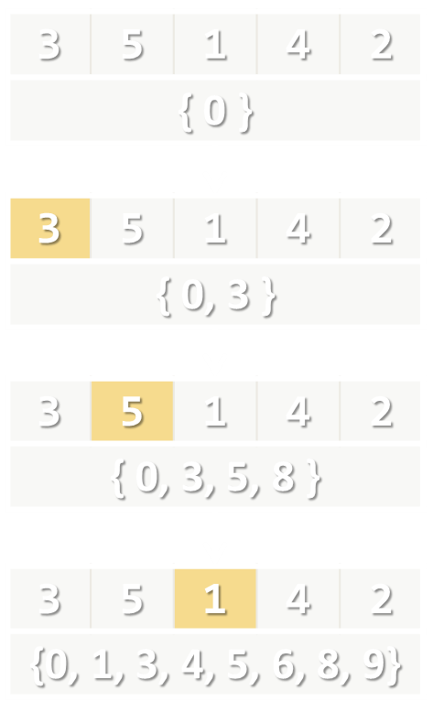
Subset Sum Problem (No Repeats)
static ISet<int> CalcPossibleSumsSet(int[] nums, int targetSum)
{
var possibleSums = new HashSet<int>() { 0 };
for (int i = 0; i < nums.Length; i++)
{
var newSums = new HashSet<int>();
foreach (var sum in possibleSums)
{
int newSum = sum + nums[i];
newSums.Add(newSum);
}
possibleSums.UnionWith(newSums);
}
return possibleSums;
}

Slide 39
Subset Sum: How to Recover the Subset?
Keep for each obtained sum in possibleSums how it is obtained
Use a dictionary instead of set:
possibleSums[s] → num
The sum s is obtained by adding num to some previously obtained subset sum
s – num gives us the previous sum
3 | 5 | 1 | 4 | 2
{ 0 → 0 }
3 | 5 | 1 | 4 | 2
{ 0 → 0 }, { 3 → 3 }
3 | 5 | 1 | 4 | 2
{ 0 → 0 }, { 3 → 3 }, { 5 → 5 }, { 8 → 5 }
3 | 5 | 1 | 4 | 2
{0 → 0 }, { 1 → 1 }, { 3 → 3 }, { 4 → 1 }, { 5 → 5 }, { 6 → 1 }, { 8 → 5 }, { 9 → 1}

Slide 40
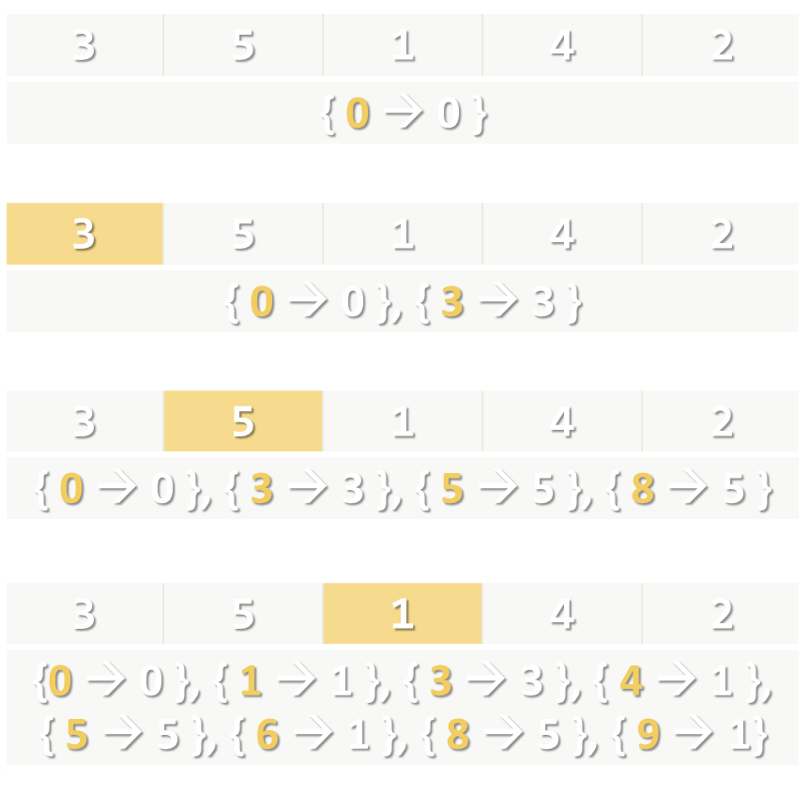
Subset Sum (No Repeats + Subset Recovery)
static IDictionary<int, int> CalcPossibleSums(
int[] nums, int targetSum) {
var possibleSums = new Dictionary<int, int>();
possibleSums.Add(0, 0);
for (int i = 0; i < nums.Length; i++) {
var newSums = new Dictionary<int, int>();
foreach (var sum in possibleSums.Keys) {
int newSum = sum + nums[i];
if (!possibleSums.ContainsKey(newSum))
newSums.Add(newSum, nums[i]);
}
foreach (var sum in newSums)
possibleSums.Add(sum.Key, sum.Value);
}
return possibleSums;
}

Slide 41
Subset Sum (No Repeats): Subset Recovery
static List<int> FindSubset(int[] nums, int targetSum,
IDictionary<int, int> possibleSums)
{
var subset = new List<int>();
while (targetSum > 0)
{
var lastNum = possibleSums[targetSum];
subset.Add(lastNum);
targetSum -= lastNum;
}
subset.Reverse();
return subset;
}
{ 9 → 1} → { 8 → 5 } → { 3 → 3 } → 0

Slide 42
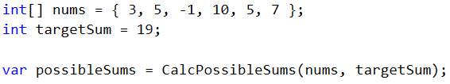
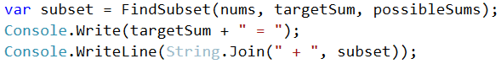
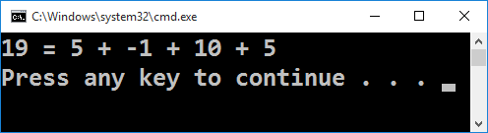
Subset Sum (with No Repeats)
Live Demo

Slide 43
Subset Sum Problem (With Repeats)
Solving the subset sum problem (BFS-based algorithm):
nums = { 3, 5, 2 }, targetSum = 6
{ 0 }
{ 0, 0+3, 0+5, 0+2 }
{ 0, 2, 3, 5 }
possibleSums = { 0 };
for i = 0 … targetSum
{
Append to possibleSums[i] all numbers from nums[]
}
{ 0, 2, 3, 5} ∪ { 2+3, 2+5, 2+2 }
{ 0, 2, 3, 4, 5, 7 }
{ 0, 2, 3, 4, 5, 7 } ∪ { 3+3, 3+5, 3+2 }
{ 0, 2, 3, 4, 5, 6, 7, 8 }
…

Slide 44
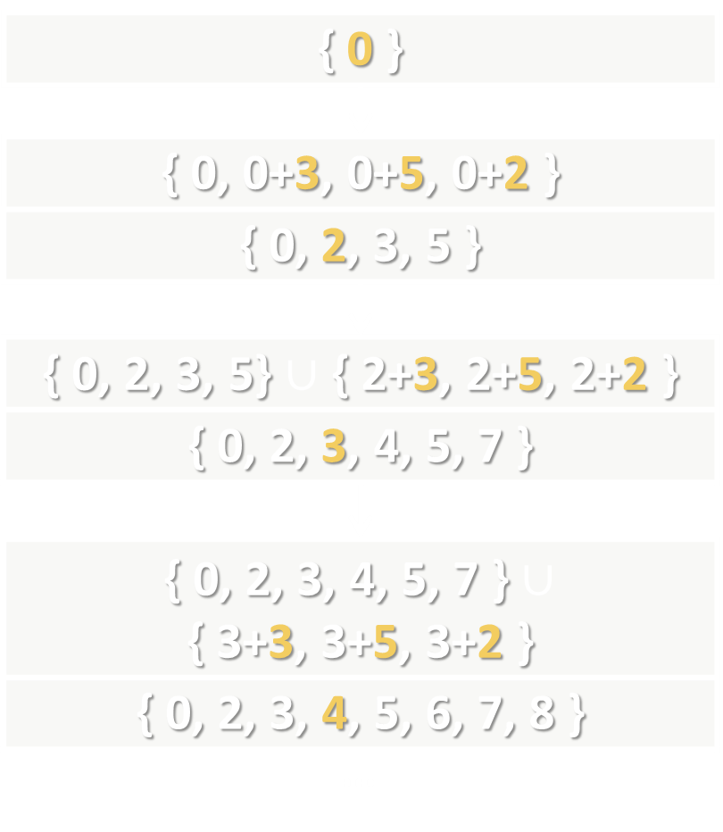
Subset Sum (With Repeats)
static bool[] CalcPossibleSums(int[] nums, int targetSum)
{
var possible = new bool[targetSum + 1];
possible[0] = true;
for (int sum = 0; sum < possible.Length; sum++)
if (possible[sum])
for (int i = 0; i < nums.Length; i++)
{
int newSum = sum + nums[i];
if (newSum <= targetSum)
possible[newSum] = true;
}
return possible;
}

Slide 45
Subset Sum (With Repeats): Recovery
private static IEnumerable<int> FindSubset(
int[] nums, int targetSum, bool[] possibleSums)
{
var subset = new List<int>();
while (targetSum > 0)
for (int i = 0; i < nums.Length; i++)
{
int newSum = targetSum - nums[i];
if (newSum >= 0 && possibleSums[newSum])
{
targetSum = newSum;
subset.Add(nums[i]);
}
}
return subset;
}

Slide 46
Subset Sum (With Repeats)
Live Demo

Slide 47
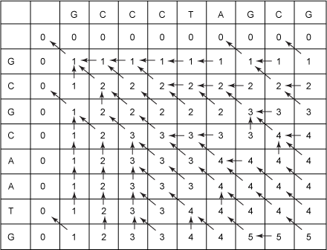
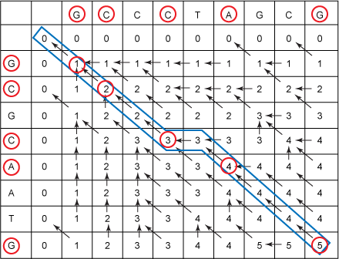
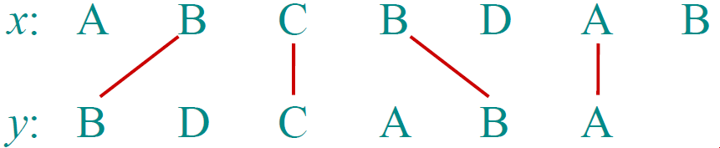
Longest Common Subsequence (LCS)
A Recursive DP Approach

Slide 48
Longest Common Subsequence (LCS)
Longest common subsequence (LCS) problem:
Given two sequences x[1 … m] and y[1 … n]
Find a longest common subsequence (LCS) to them both
Example:
x = "ABCBDAB"
y = "BDCABA"
LCS = "BCBA"

Slide 49
LCS – Recursive Approach
S₁ = GCCCTAGCG, S₂ = GCGCAATG
Let C₁ = the right-most character of S₁ (C₁ = G)
Let C₂ = the right-most character of S₂ (C₂ = G)
Let S₁' = S₁ with C₁ "chopped-off" (S₁' = GCCCTAGC)
Let S₂' = S₂ with C₂ "chopped-off" (S₂' = GCGCAAT)
There are three recursive sub-problems:
L₁ = LCS(S₁', S₂)
L₂ = LCS(S₁, S₂')
L₃ = LCS(S₁', S₂')

Slide 50
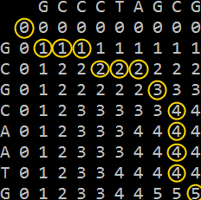
LCS – Recursive Formula
Let lcs[x, y] be the longest common subsequence of S₁[0 … x] and S₂[0 … y]
LCS has the following recursive properties:
lcs[-1, y] = 0
lcs[x, -1] = 0
lcs[x, y] = max(
lcs[x-1, y],
lcs[x, y-1],
lcs[x-1, y-1]+1 when S₁[x] == S₂[y]
)

Slide 51
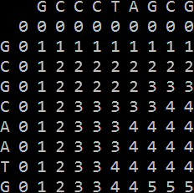
Calculating the LCS Table
static int CalcLCS(int x, int y) {
if (x < 0 || y < 0)
return 0;
if (lcs[x, y] == NOT_CALCULATED) {
int lcsFirstMinusOne = CalcLCS(x - 1, y);
int lcsSecondMinusOne = CalcLCS(x, y - 1);
lcs[x, y] = Math.Max(
lcsFirstMinusOne, lcsSecondMinusOne);
if (firstStr[x] == secondStr[y]) {
int lcsBothMinusOne = 1 + CalcLCS(x - 1, y - 1);
lcs[x, y] = Math.Max(lcs[x, y], lcsBothMinusOne);
}
}
return lcs[x, y];
}

Slide 52
Reconstructing the LCS Sequence
static string PrintLCS(int x, int y) {
var lcsLetters = new List<char>();
while (x >= 0 && y >= 0)
if ((firstStr[x] == secondStr[y]) &&
(CalcLCS(x - 1, y - 1) + 1 == lcs[x, y])) {
lcsLetters.Add(firstStr[x]);
x--;
y--;
}
else if (CalcLCS(x - 1, y) == lcs[x, y])
x--;
else
y--;
lcsLetters.Reverse();
return string.Join("", lcsLetters);
}

Slide 53
Longest Common Subsequence (LCS)
Live Coding (Lab)

Slide 54

Summary
DP → Solve a problem by solving overlapping subproblems
Memoization → Save subproblem solutions for later use
Optimal Substructure
Subproblems should have optimal solutions
Combine optimal solutions for subproblems
Get optimal solution for original problem
Top down approach – Recursive
Bottom up approach – Iterative

Slide 55







Dynamic Programming
https://softuni.bg/opencourses/algorithms

Slide 56
License
This course (slides, examples, labs, videos, homework, etc.) is licensed under the "Creative Commons Attribution-NonCommercial-ShareAlike 4.0 International" license
Attribution: this work may contain portions from
"Fundamentals of Computer Programming with C#" book by Svetlin Nakov & Co. under CC-BY-SA license
"Data Structures and Algorithms" course by Telerik Academy under CC-BY-NC-SA license

Slide 57





Trainings @ Software University (SoftUni)
Software University – High-Quality Education, Profession and Job for Software Developers
softuni.bg
Software University Foundation
http://softuni.foundation/
Software University @ Facebook
facebook.com/SoftwareUniversity
Software University Forums
forum.softuni.bg

